Slide 1

REDCap New Feature: Embedded Fields
Presented by CCTST’s REDCap Program Administrators:
Maxx Somers, MA | REDCap Program Manager
Theresa Bakers, MS | REDCap Training & Development Specialist
Division of Biomedical Informatics

Slide 2
Research Electronic Data Capture is a web-based application used to create and manage databases and surveys in order to support data capture for research studies.

Slide 3














Data collection
Data Storage
Export

Slide 4
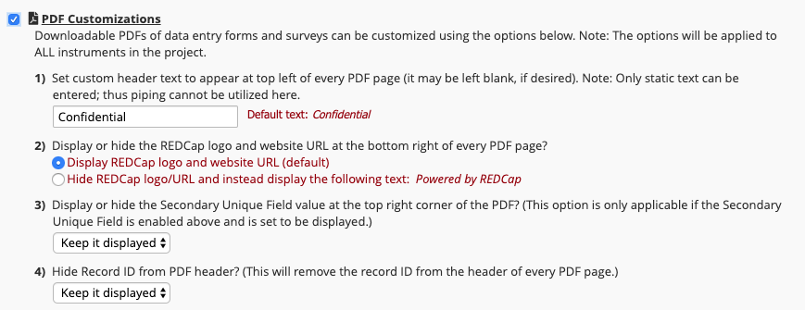
Improvement: New PDF customization to hide the Record ID from the PDF header. In the "PDF Customizations" section of the "Additional Customizations" dialog on the Project Setup page, users may set this option to display or hide the record name in the top header of every PDF page when downloading a PDF with data for a record. This is a project-level setting, so setting it applies to all PDFs generated for records in the project.

Slide 5
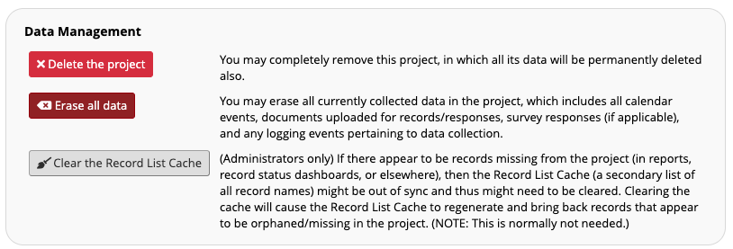
Improvement/change: A new "Clear the Record List Cache" button has been added to the Other Functionality page in a project, in which this button is only available to administrators to use. If there appear to be records missing from the project (in reports, record status dashboards, or elsewhere), then the Record List Cache (a secondary list of all record names) might be out of sync and thus might need to be cleared. Clearing the cache will cause the Record List Cache to regenerate and bring back records that appear to be orphaned/missing in the project. Clicking this button will clear the cache and fix the record list. NOTE: This is normally not needed, but there have been instances in which unknown factors caused the Record List Cache to get out of sync, which could cause major problems for some projects.

Slide 6
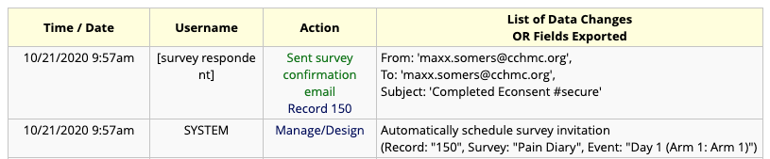
Improvement/change: The sending of a survey confirmation email now gets logged on the project Logging page when a confirmation email has been set to send to a survey participant after having completed a survey, in which the logged event will note the record name, the To address, the From address, the email subject, and whether or not the email contained attachments (including the PDF of the participant's survey responses).

Slide 7
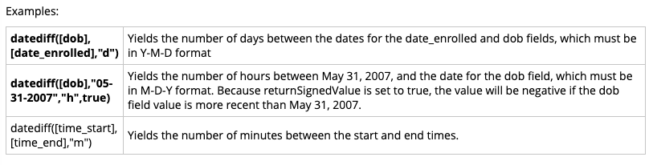
Changes for long-standing quirks with calc fields and branching logic
Change: In previous versions, calculated fields could only utilize either numeric fields or date/datetime fields in the calculation. Now non-numeric fields may be used, most notably inside IF statements. For example, if ([field1] = “A”, 0, 99).
Change: In previous versions, using > or < in branching logic would not always work as expected. For example, [a] > [b] would have to be formatted as [a]*1 > [b]*1 to work correctly 100% of the time, which is not intuitive. This is no longer required, in which [a] > [b] will work as one would expect in branching logic. Note: This does not apply to calc fields, which have never had this problem.
Change/improvement: The datediff() function used in branching logic and calc fields no longer requires the date format parameter (“ymd”, “mdy”, “dmy”). This was required for datediff() in calc fields and branching logic but was not required elsewhere, such as in report filters, DQ rule logic, ASI/Alert conditions, etc. The $returnSignedValue parameter (if provided) can now be provided as the fourth parameter - e.g., datediff([dob], “today”, “y”, true). NOTE: Both of the date/datetime fields used in the datediff function must still be in the same date format (“mdy”, “dmy”, or “ymd”), so that is still a requirement.

Slide 8
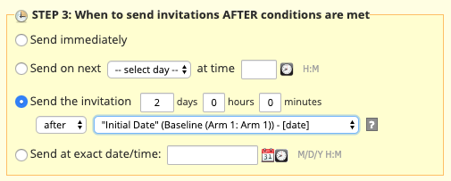
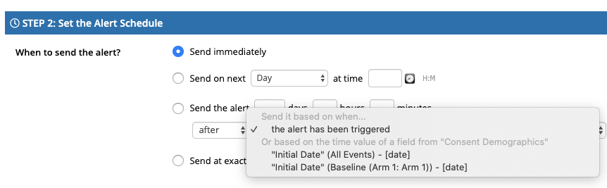
Improvement: A new send-time option has been added when setting up Automated Survey Invitations and Alerts & Notifications. When defining when the ASI/Alert should be sent, the option “Send after a lapse of time” has a new setting added so that, if desired, the user may set the time lapse relative to the value of a date or datetime field in the project. In previous versions, the time lapse setting could only be set relative to the time in which the ASI/Alert was triggered. That is still an option, but now users may also opt to send the ASI/Alert a certain amount of time either before or after the date/time of a specific field. This new setting will allow users to have greater control with regard to setting when ASIs/Alerts will be sent without getting too complicated in their setup, such as having to use complex logic (with datediff, etc.).

Slide 9
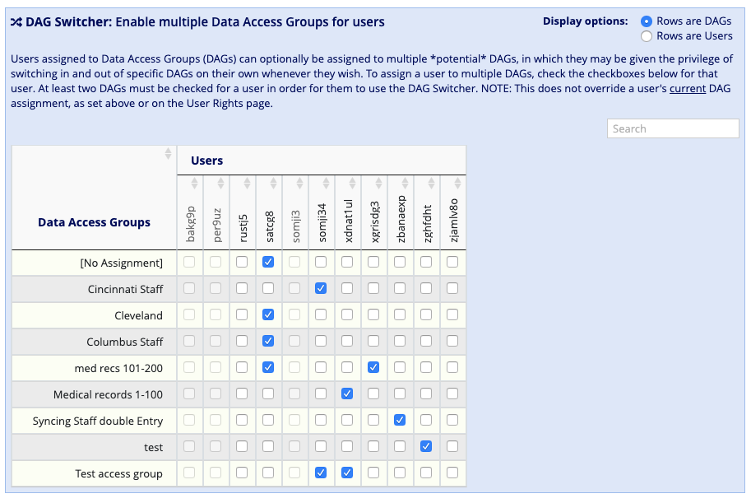
New feature: DAG Switcher
Users assigned to Data Access Groups (DAGs) can optionally be assigned to multiple *potential* DAGs, in which they may be given the privilege of switching in and out of specific DAGs on their own whenever they wish.
When assigned to multiple DAGs, the user will see a blue banner at the top of every project page, which will present them with the option to switch to another DAG. NOTE: Users may not move themselves into another DAG unless someone with rights to this page has explicitly granted them privileges to be in multiple DAGs.

Slide 10
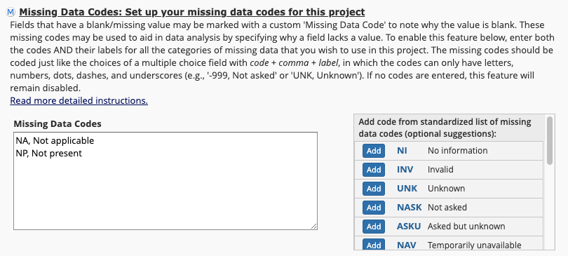
Improvement/change: Users are now able to utilize dots/periods/full stops in the codings of choices for checkbox fields. In previous versions of REDCap, this was not allowed for checkbox fields. (Ticket #83002)
Improvement/change: By popular demand, users may once again utilize dots/periods/full stops in Missing Data Codes. They are no longer forbidden. They were originally allowed for Missing Data Codes, but then removed in REDCap 8.5.0. Now that checkboxes can have dots/periods in their codings as of v9.9.0, it is no longer an issue for Missing Data Codes to use them too. (Ticket #83002)

Slide 11
Project life cycle changes
  Change: The "Archived" project status has been removed and converted into a built-in Project Folder named "My Hidden Projects", as now seen at the bottom of each user’s My Projects page. If users wish to hide any projects from their My Projects list, they may click the Organize button on that page and place the projects into that new Project Folder. NOTE: Any already-archived projects will be automatically placed there and will have their project status set as "Analysis/Cleanup" to match the projects’ general behavior prior to the upgrade.
  Change: The "Inactive" project status has been renamed to "Analysis/Cleanup" status to help reinforce that cleaning and analyzing the data is the next logical step after data collection in Production status.
  New feature: Projects that are in "Analysis/Cleanup" status can now optionally have their project data set as "Locked/Read-only" or "Editable" (see the top of the Project Setup or Project Home page). This will give users more control to prevent data collection from happening while in this project status.
  Change: New records can no longer be created while in "Analysis/Cleanup" status. If users wish to create records, the project must be moved back to Production status.
  New feature: Mark a project as "Completed": If users are finished with a project and wish to make it completely inaccessible, they may mark the project as Completed. Doing so will take it offline and remove it from everyone's project list, after which it can only be seen again by clicking the Show Completed Projects link at the bottom of the My Projects page. Once marked as Completed, no one in the project (except for REDCap administrators) can access the project, and only administrators may undo the Completion and return it back to an accessible state for all project users. Marking a project as Completed is typically only done when users are sure that no one needs to access the project anymore, and they want to ensure that the project and its data remain intact for a certain amount of time.

Slide 12
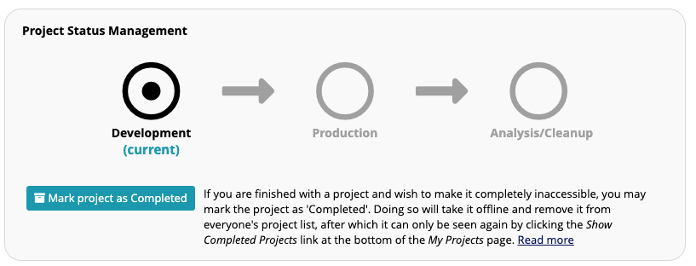
Project life cycle changes

Slide 13
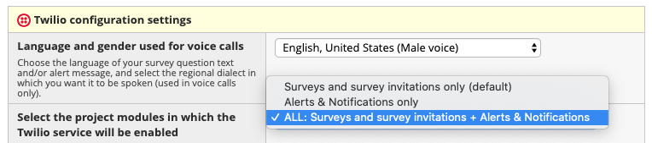
New feature: SMS and Voice Calls for Alerts & Notifications
The Twilio telephony services must first be enabled on the project on the Project Setup page (the same way it has in the past when utilizing Twilio for surveys and survey invitations), and once enabled, using the Twilio configuration dialog users may choose to utilize Twilio in the project for surveys (default), alerts, or both surveys and alerts.
Once enabled for alerts, inside the Add/Edit Alert dialog on the Alerts & Notifications page users will see the options to send a notification as an email, SMS message, or voice call.
Note: Just as when SMS messages are sent and when voice calls are made via Twilio for surveys, REDCap has a cron job that runs every 2 minutes that will automatically delete all logs on the Twilio website for any SMS messages sent or voice calls made via Alerts & Notifications. This is for privacy reasons to remove any potentially sensitive information (e.g., recipient phone numbers) that might be stored in Twilio’s logs.

Slide 14
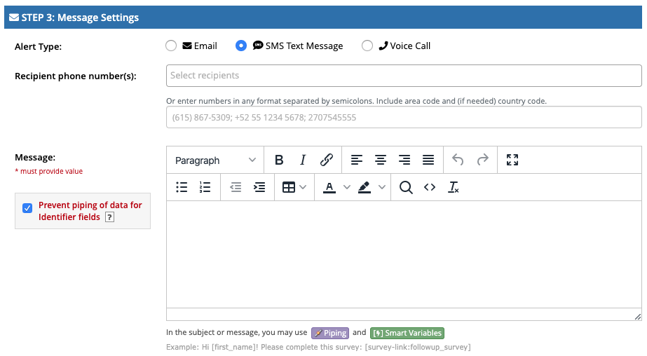

Slide 15
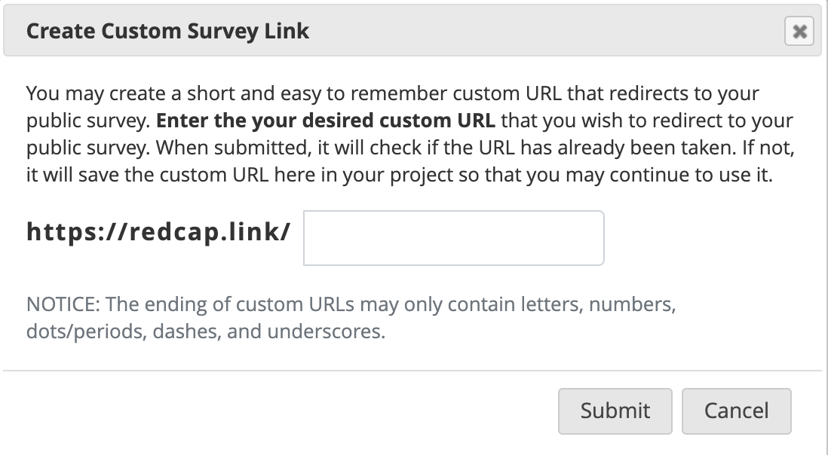
New feature: REDCap-branded URL Shortener (https://redcap.link)
The “Get short survey link” and “Create custom survey link” buttons on a project’s Public Survey Link page now utilize the REDCap-branded URL Shortener (https://redcap.link) instead of BIT.LY and IS.GD, which are third-party websites utilized by previous versions.

Slide 16
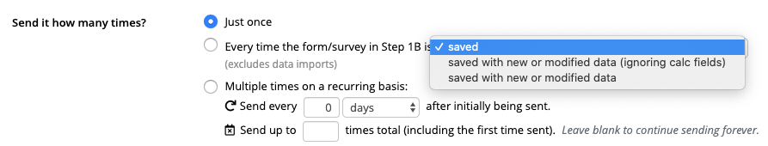
Improvement: New options for Alerts & Notifications
A “Trigger Limit” setting was added to Step 1 in the Add/Edit Alert popup that allows users to define where and to what extent within a record that the alert will be triggered. Its options include “only once per record”, “only once per event”, “only once per instrument regardless of the event”, and others that are displayed if the project contains repeating instruments/events. The trigger limit will help users to limit alerts to only be triggered on certain parts of a record and/or so many times within a record to achieve the behavior they desire for their notifications. Note: For non-longitudinal projects that do not have repeating instruments, this option (Step 1C) will not be displayed at all since it would contain only one choice: “only once per record”. (Ticket #70860)
The “every time” option of the “Send it how many times?” setting in Step 2 has been expanded to have sub-options to provide more possible scenarios in which an alert will be triggered. In previous versions, the only option was to set an alert to be triggered “every time the form/survey in Step 1B is saved”, but now it contains two new variations: “every time the form/survey in Step 1B is saved with new or modified data” and “every time the form/survey in Step 1B is saved with new or modified data (ignoring calc fields)”.
Recurrence maximum - When setting an alert to send multiple times in a recurring fashion in Step 2, a new option has been added to limit the maximum number of recurrences (i.e., the total times the alert will be sent on its repeated schedule). In previous versions, the alert would continue sending indefinitely at its defined interval (typically until conditional logic became no longer true), but now the alert can be set to repeat up to 9999 times at the interval that has been defined.

Slide 17
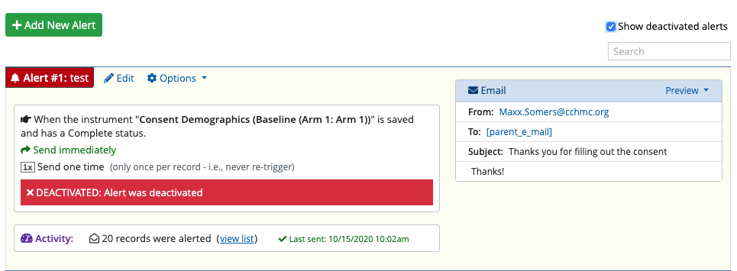
Improvement/change: On the Alerts & Notifications page, users may now edit a deactivated alert. This is especially useful if a user is setting up part of an alert and wishes to make incremental edits to the alert prior to re-enabling it.

Slide 18
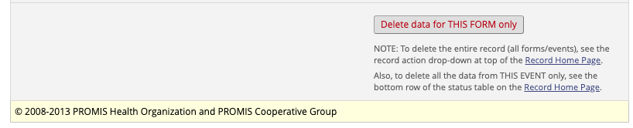
Improvement: Adaptive and Auto-scoring instruments (i.e., PROMIS assessments) that have been downloaded from the REDCap Shared Library may now have their survey responses deleted via the Delete button at the bottom of the data entry form when viewing the survey response. In previous versions, if an Adaptive and Auto-scoring instrument had been partially completed or the wrong one had been taking accidentally, there was no way to remove the existing response since the whole response was locked afterward. Now the "Delete data for THIS FORM only" button appears at the bottom to allow users to remove the response if they wish to add another to replace it.

Slide 19
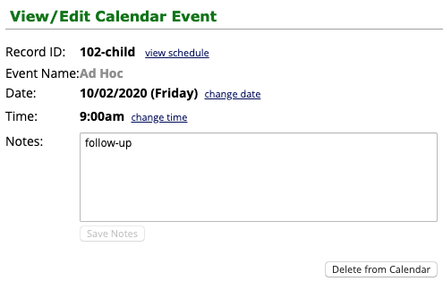
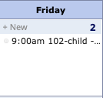
Improvement: If the Custom Record Label and/or Secondary Unique Field are being used in a project, their values will now be displayed on the Calendar page when viewing the Day or Agenda tab for any calendar event connected to a record in the project.

Slide 20
Field Embedding
Change the look of a survey or form by repositioning field elements

Slide 21
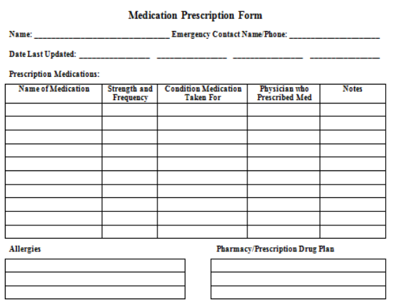
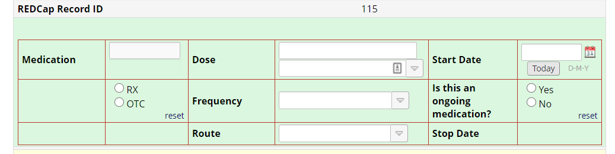
What is Field Embedding?
Change the look of a survey or form by repositioning field elements.

Slide 22
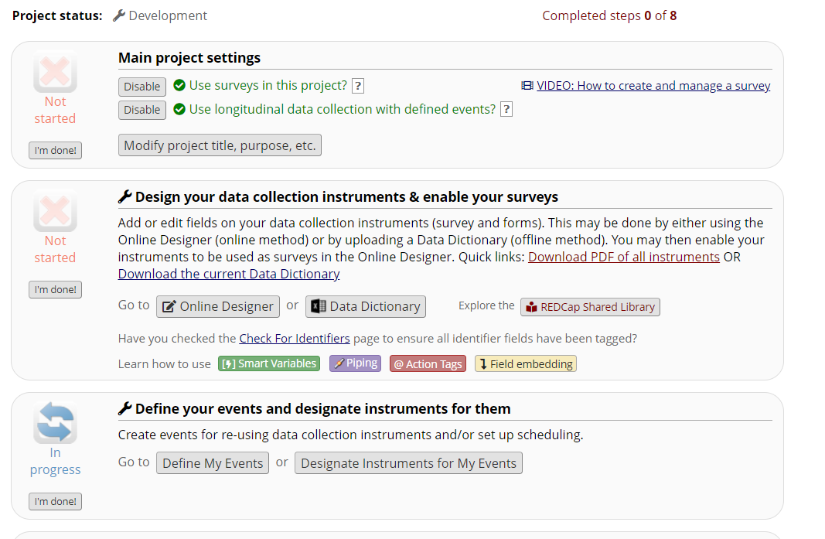

Slide 23
How to embed a field
First, create the field. The field must exist first before it can be embedded elsewhere.
Place the REDCap variable name of the field you wish to embed inside braces/curly brackets and place it in the Field Label, Field Note, Section Header, or Choice Label of another field on that same instrument.

Slide 24
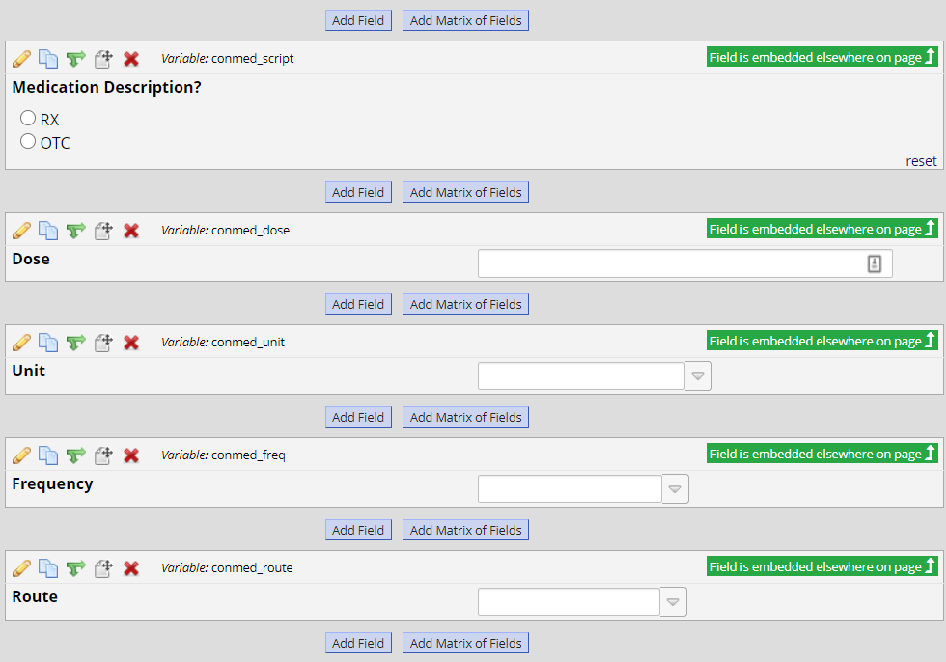
Create the field
Notes:
https://redcap.research.cchmc.org/redcap_v10.0.15/Design/online_designer.php?pid=4791&page=concomitant_medications

Slide 25
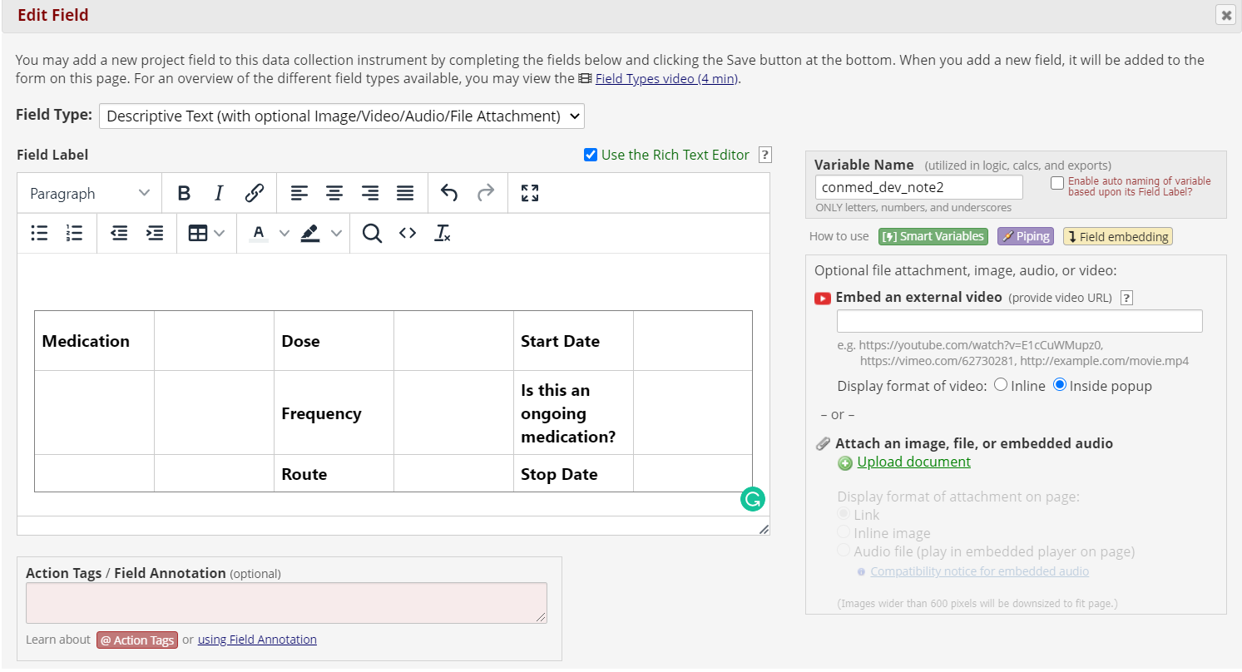
Go new location
Notes:
https://redcap.research.cchmc.org/redcap_v10.0.15/Design/online_designer.php?pid=4791&page=concomitant_medications

Slide 26
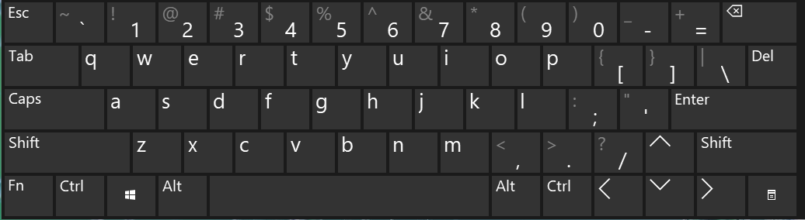
Place {variable} in curly brackets
Notes:
https://redcap.research.cchmc.org/redcap_v10.0.15/Design/online_designer.php?pid=4791&page=concomitant_medications

Slide 27
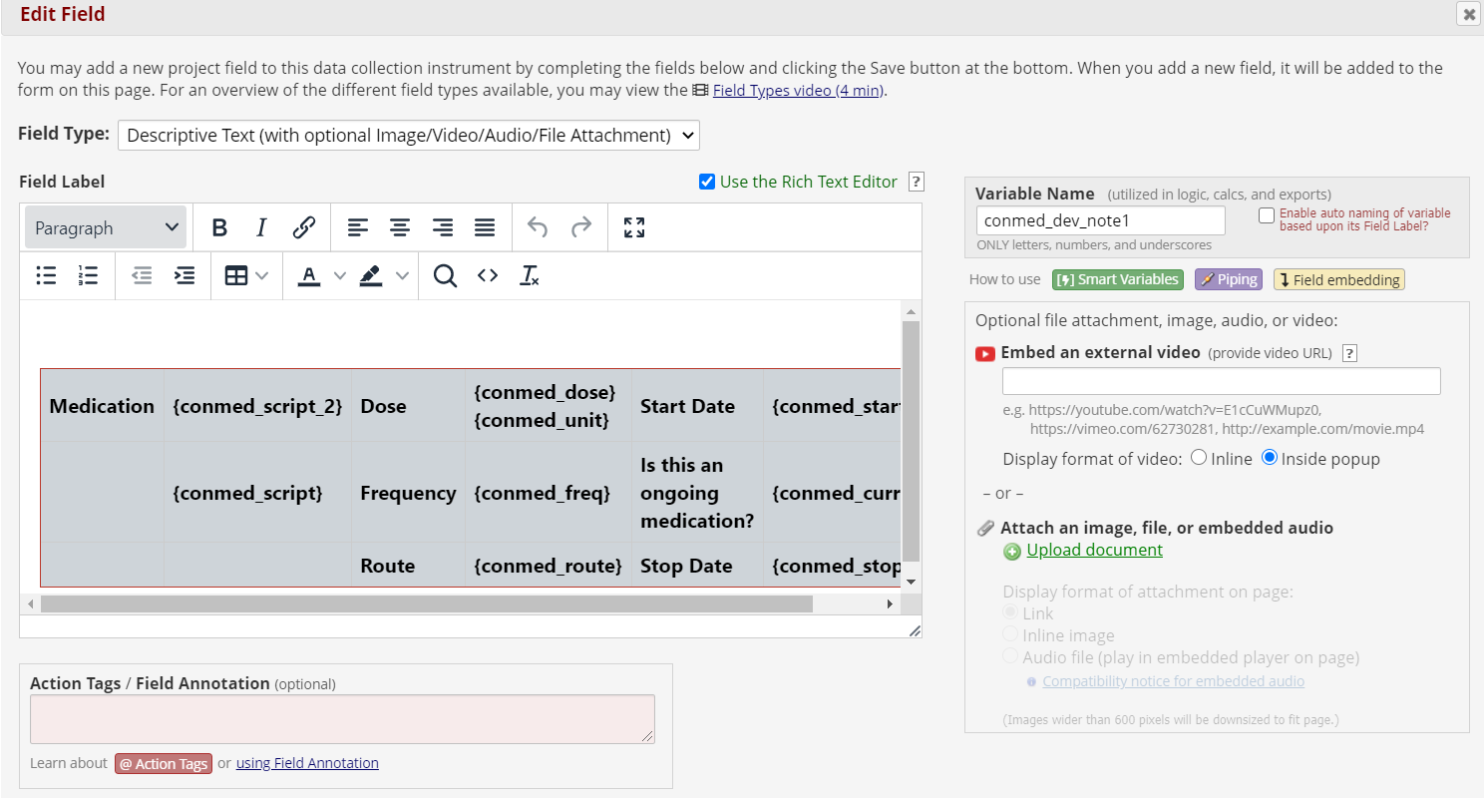
2. Go new location of variable and place {variable} in curly brackets
Notes:
https://redcap.research.cchmc.org/redcap_v10.0.15/Design/online_designer.php?pid=4791&page=concomitant_medications

Slide 28
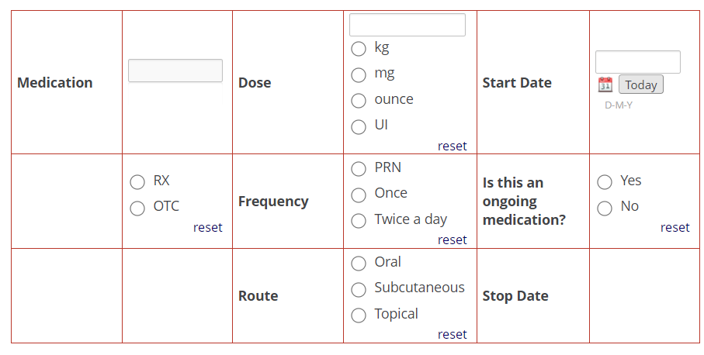

Slide 29
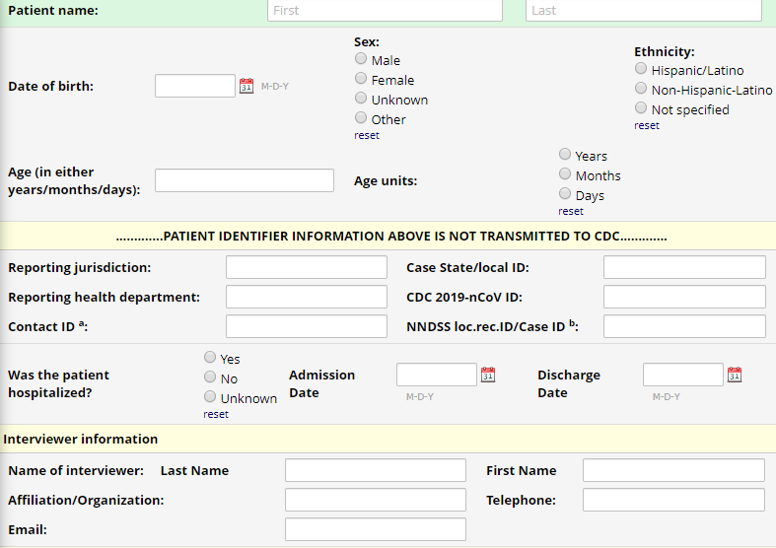

Slide 30
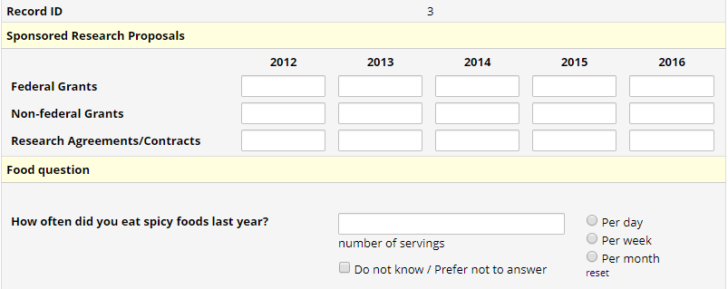

Slide 31

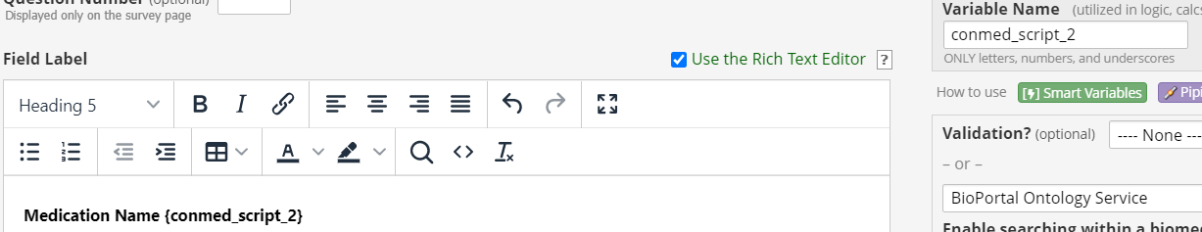
Recommendations and limitations for usage
A field cannot be embedded inside itself (i.e., in its own Field Label), and a field cannot be embedded in another field's Field Label or Field Note if that field is also embedded elsewhere.

Slide 32
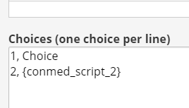

Recommendations and limitations for usage
  A field *can* be embedded into a Choice Label of a multiple choice field (with the exception of drop-down fields) that is also embedded elsewhere; this would be considered compound embedding.

Slide 33
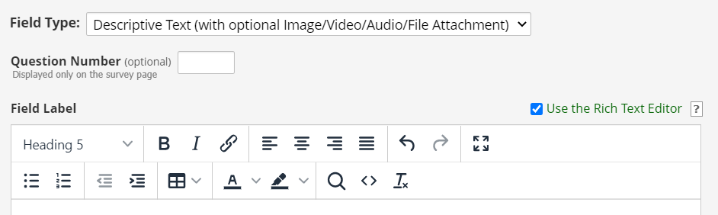
Recommendations and limitations for usage
The most common place to embed a field is in the Field Label of a Descriptive field.
  Descriptive fields are merely blocks of text, so they are excellent for using the rich text editor to build tables or complex structures for placing your text and embedded fields.

Slide 34
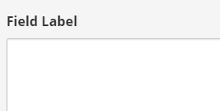
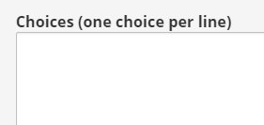
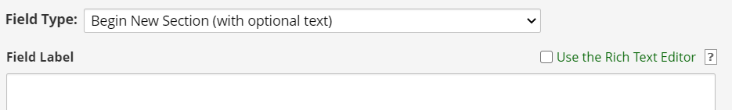

Recommendations and limitations for usage
Fields may be embedded only in the following places: the Field Label, Field Note, Section Header, or Choice Label of another field on the same instrument, or if on a multi-page survey, the embedded field must be on the same survey page as its host field.
  Note: Fields cannot be embedded into drop-down labels, survey instructions, survey acknowledgment text, survey queue text, or into any outgoing emails/invitations/alerts.

Slide 35
Recommendations and limitations for usage
Field embedding will only relocate the actual input element (e.g., the text box, radio buttons). It will not relocate the field label or field note, although it *will* relocate the choice label for radio/checkbox fields so that the radio/checkbox choices maintain their labels.
  Additionally, the original location of the field being embedded will be completely hidden after it is relocated, which means that the field's true field label, field note, etc. will never actually be seen on the survey/instrument. It is recommended to add a Field Label even if the field is being embedded because the label will still be needed when viewing a report.

Slide 36
Recommendations and limitations for usage
Adding the field icons: The usual icons pertaining to a field's Data History, Field Comments, and (if enabled) Missing Data Codes can be displayed on a data entry form (but not on a survey) next to the embedded field's new location by appending :icons to the variable name inside the braces/curly brackets - e.g., {last_name:icons}. The icons do not appear by default but only when the ':icons' signifier is attached.

Slide 37
Recommendations and limitations for usage
Field embedding does not work in the REDCap Mobile App. If a project with embedded fields is loaded into the mobile app, it will not look how it does on a REDCap survey/instrument webpage.

Slide 38
Recommendations and limitations for usage
The branching logic for that field will operate as it normally does, in which the embedded field will be hidden when its branching logic evaluates to FALSE.

Slide 39
Recommendations and limitations for usage
The Record ID field (the first field in the project) cannot be embedded because it is a special field.

Slide 40
Recommendations and limitations for usage
*Embedded fields and eConsent Framework note:
  Version 10.0.15 does not support embedding signature fields with the eConsent Framework.
  Signatures will not appear on the PDF.

Slide 41
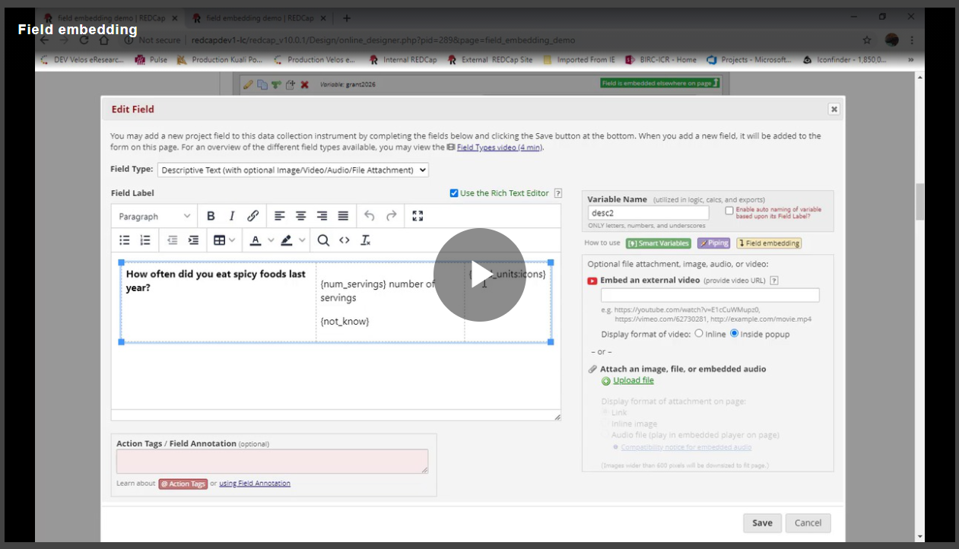
Embedded Fields Training Video
Developed by Leila Deering at Marshfield Clinic Research Institute.
https://players.brightcove.net/pages/v1/index.html?accountId=1964492288001&playerId=default&videoId=6163750638001

Slide 42

  https://confluence.research.cchmc.org/display/CCTSTRED/Cincinnati+REDCap+Resource+Center

Slide 43

https://www.cctst.org/
Notes:
Request a project at CCTST.org
CCTST offers classes
Introduction to REDCap
REDCap for Beginners
Project Management and Design in REDCap

Slide 44


help-redcap@bmi.cchmc.org
Name:
Project’s PID or URL:
Need, problem, or question: Give specifics and provide examples if applicable

